Slide 1
Lab session#6: Sorting
Kamil Salakhiev

Slide 2
Sorting algorithms
Simple sorting algorithms:
Bubble sort
Insertions sort
Selection sort
Complex sorting algorithms:
Quick sort
Heap sort
Merge Sort

Slide 3
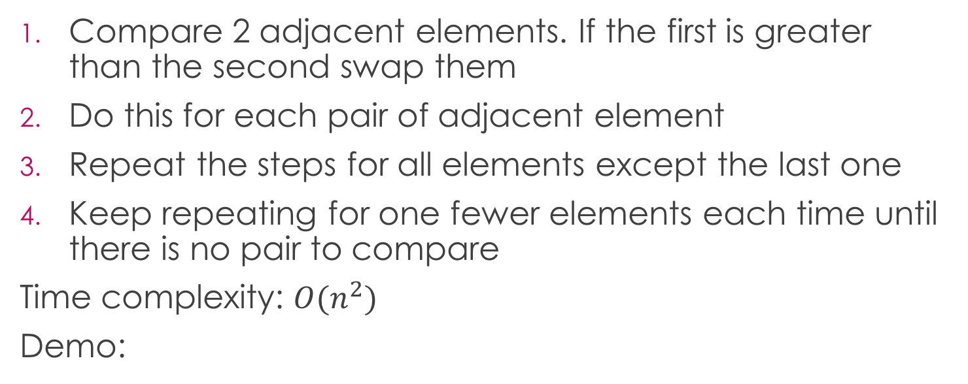
Bubble sort
Compare 2 adjacent elements. If the first is greater than the second swap them
Do this for each pair of adjacent element
Repeat the steps for all elements except the last one
Keep repeating for one fewer elements each time until there is no pair to compare
Time complexity: $O(n^{2})$
Demo:

Slide 4
Bubble sort
public void bubbleSort(Integer[] arr) { for (int i = arr.length - 1; i > 0; i--) { for (int j = 0; j < i; j++) { if (arr[j] > arr[j + 1]) swap(arr, j, j + 1); } } }

Slide 5
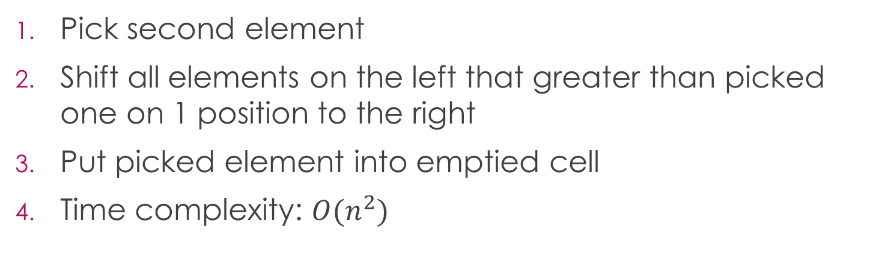
Insertion sort
Pick second element
Shift all elements on the left that greater than picked one on 1 position to the right
Put picked element into emptied cell
Time complexity: $O(n^{2})$

Slide 6
Insertion sort
public static void insertionSort(Integer[] arr) { for (int i = 1; i < arr.length; i++) { int key = arr.get[i]; int j = i-1; while(j >= 0 && arr[j]) > key){ arr[j+1] = arr[j]); j--; } arr[j+1] = key; } }

Slide 7
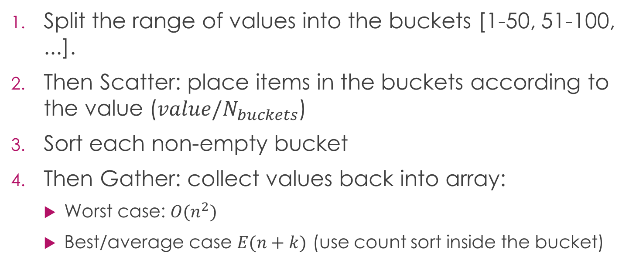
Bucket Sort
Split the range of values into the buckets [1-50, 51-100, ...].
Then Scatter: place items in the buckets according to the value ($value/N_{buckets}$)
Sort each non-empty bucket
Then Gather: collect values back into array:
Worst case: $O(n^{2})$
Best/average case $E(n+k)$ (use count sort inside the bucket)

Slide 8
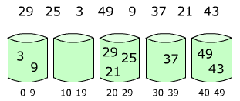
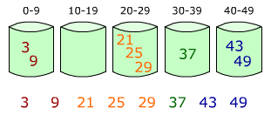
Bucket Sort

